Slide 1



Accelerating Ather's Revenue Growth
Name: Abhik Sarkar
ID: 301333781

Slide 2


Overview
Boosting Revenue Growth Rate
01
The Challenge
02
Our Objectives
03
Data Sources
04
Experience
05
Modeling Approach
06
Feature Importance
07
Business Implications
09
Recommendations
10
Implementation Roadmap
11
Recommendations For Future Studies
12
Conclusion
13

Slide 3
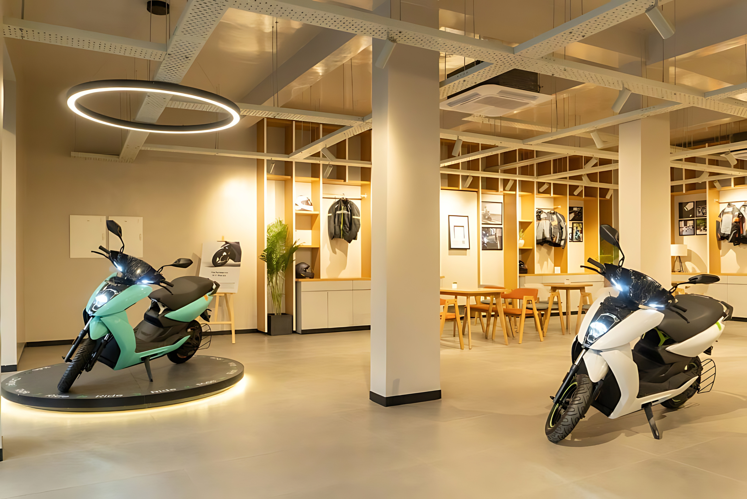
Boosting Revenue Growth Rate
Purpose: Our goal is to improve Ather Inc.'s revenue growth by analyzing supply chain data from leading tech companies.
Importance: Effective supply chain management is key to Ather's success in the electric vehicle market, and optimizing it can significantly enhance revenue growth.

Slide 4
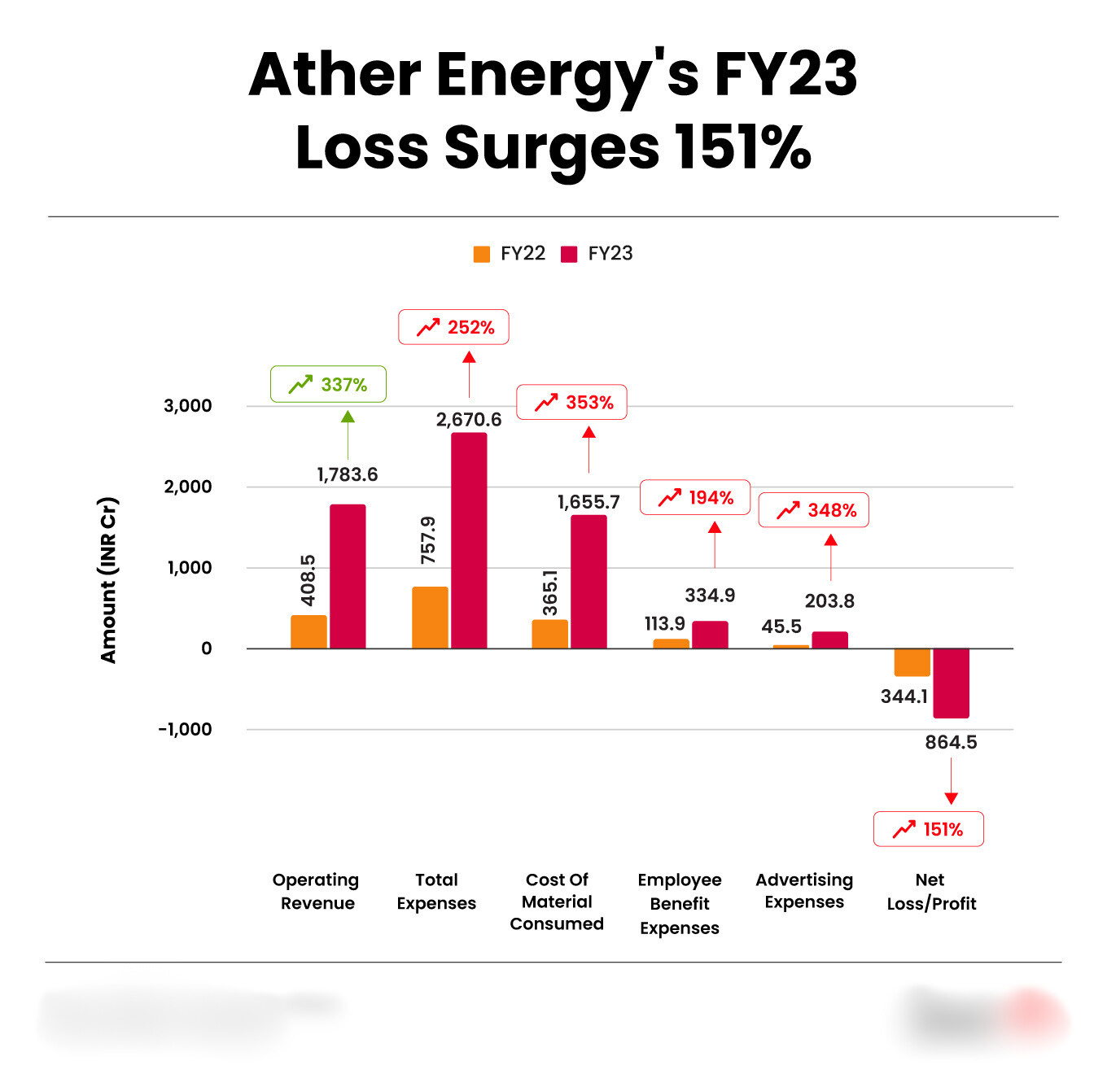
The Challenge
Problem in balancing efficiency, sustainability, and customer satisfaction in its supply chain.
Supply chain inefficiencies and disruptions risk lost sales, higher costs, and slower revenue growth.
Notes:
Current Situation: Ather Inc. faces the challenge of balancing efficiency, sustainability, and customer satisfaction in its supply chain.
Impact on Revenue: Inefficiencies and disruptions in the supply chain can lead to lost sales, increased costs, and ultimately, slower revenue growth.

Slide 5





Our Objectives
Supply Chain Factors
Identify key supply chain factors that influence revenue growth.
Actionable Insights
Provide actionable insights to optimize these factors.
Suggestions
Suggesting strategies to enhance Ather’s overall supply chain performance.

Slide 6




Data Sources
Internal Dataset
Key Data Points
Relevance
The dataset used in the analysis was company’s historical dataset.
Supply Chain Performance.
Efficiency Metrics .
Risk Factors.
Data Significance.
Revenue Impact.
Notes:
Supply Chain Performance: Metrics like Supplier Lead Time, Order Fulfillment Rate, Inventory Accuracy.
Efficiency Metrics: Indicators such as Inventory Turnover Ratio, and Lead Times.
Risk Factors: Data on Supply Chain Risk Percentage and Resilience Scores.
Relevance
Data Significance: These data points are crucial for optimizing Ather Inc.'s supply chain, enhancing efficiency, and mitigating risks.
Revenue Impact: The insights gained from this data are directly linked to improving Ather Inc.'s revenue growth by making data-driven decisions.

Slide 7
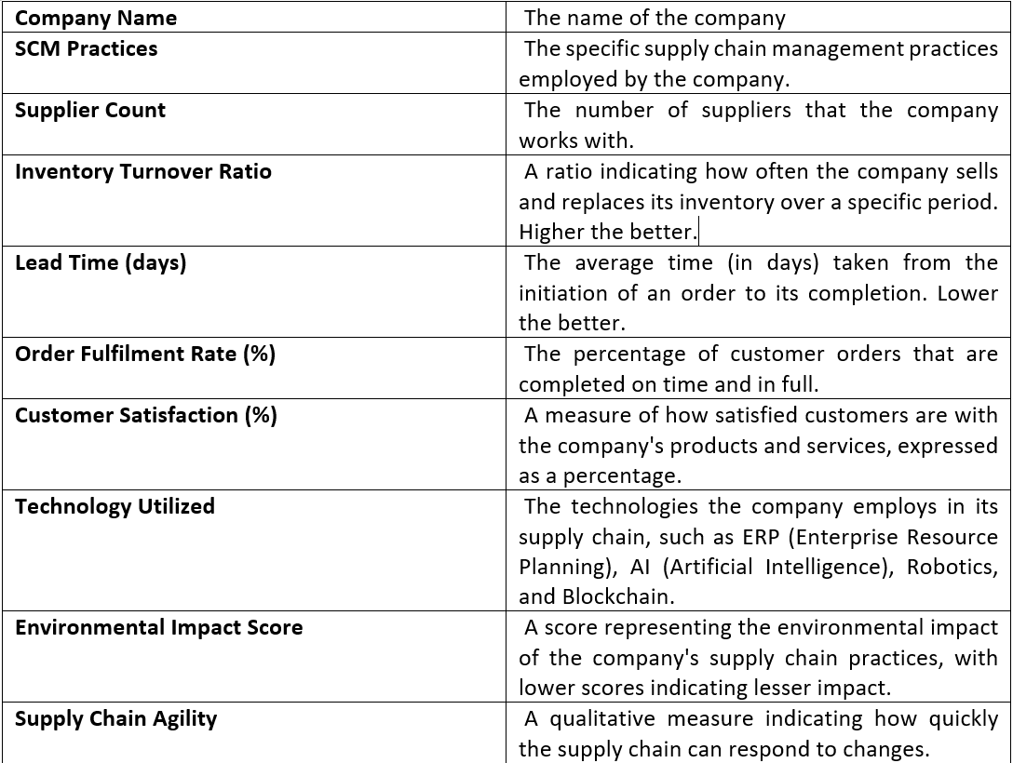
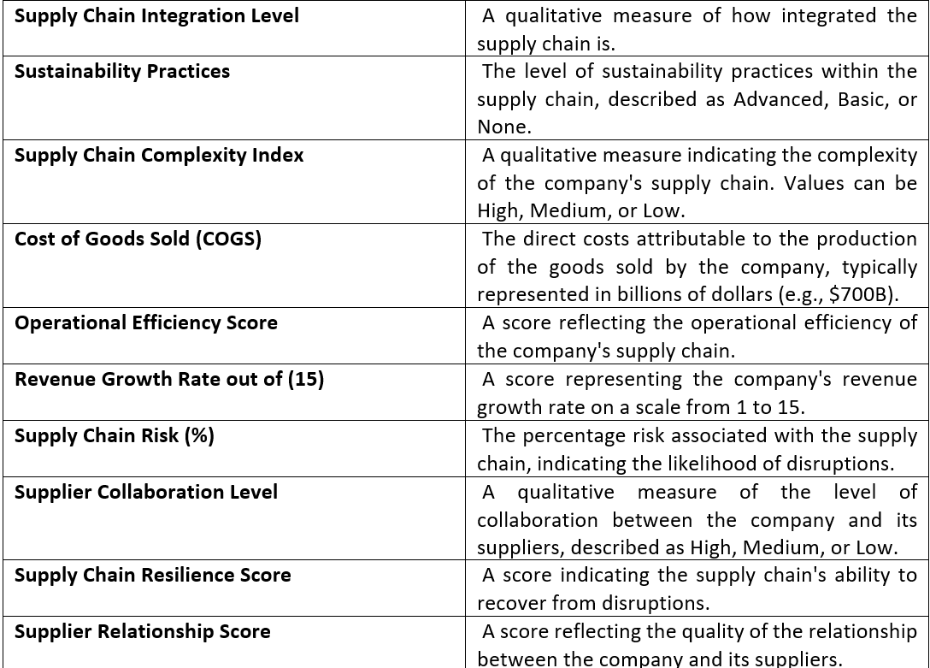
Data Dictionary

Slide 8






Modeling Approach
Three types of modeling were performed: Decision Tree (DT), Random Forest (RF), and Linear Regression (LR). Among these, the Random Forest model delivered the best performance.
Random Forest
Decision Tree
Linear Regression
Mse: 0.7508403166666667
Rmse: 0.8665104250190339
Mse: 1.1714285714285715
Rmse: 1.082325538564332
Mse: 1.6791962349522596
Rmse: 1.295838043488560

Slide 9
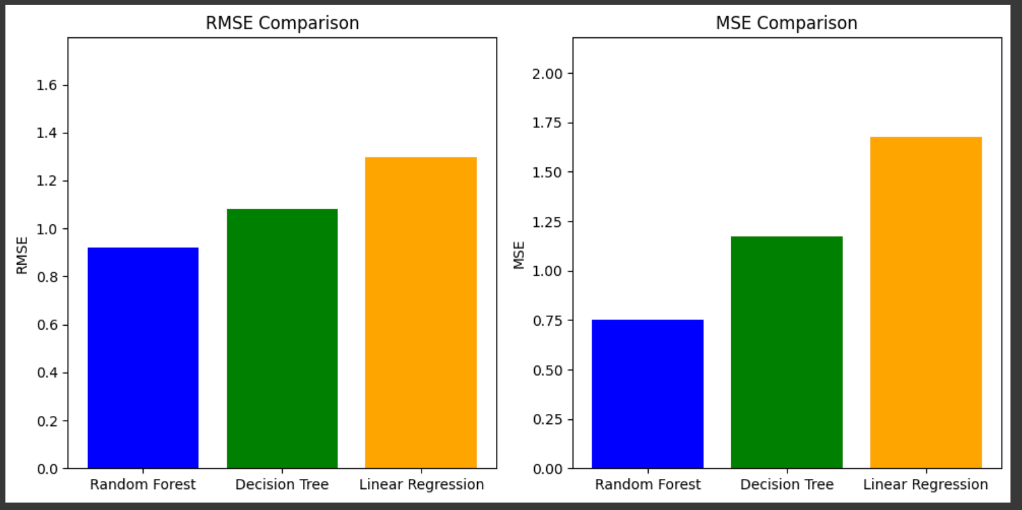
Model Comparison

Slide 10

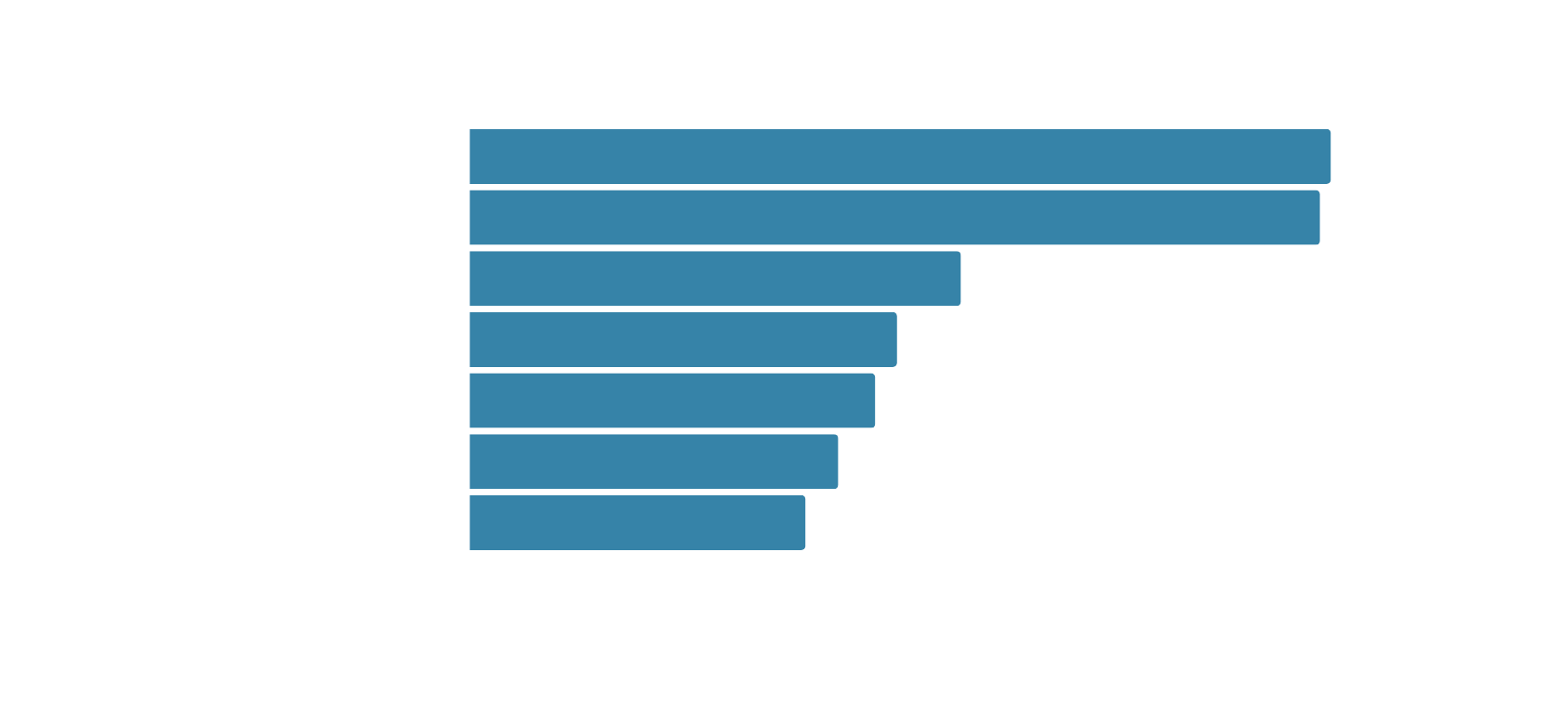
Feature Importance
(Random Forest)
Feature importance score

Slide 11
Business Implications
Optimization Focus
Implement referral programs to get new leads and talent.
Risk Management
Diversify client acquisition strategies to balance growth and financial stability.
Market Positioning
Regularly adjust service offerings based on competitive analysis and industry trends.
Expected Outcomes
Establish measurable targets for client diversity across industries, sizes, and locations.

Slide 12

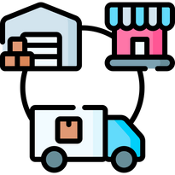


Recommendations
Optimize Supplier Lead Time
Enhance Order Fulfillment Rate
Invest In Newer Technolgy
Mitigate Supply Chain Risk
Notes:
Optimize Supplier Lead Time:
Focus on reducing variability in supplier lead times.
Collaborate closely with suppliers to streamline and standardize processes.
Improved predictability will directly enhance production scheduling and reduce delays.
Enhance Order Fulfillment Rate
Improve the accuracy and efficiency of order fulfillment.
Implement advanced inventory management systems and forecasting techniques
Ensures timely delivery, improving customer satisfaction and sales.
Mitigate Supply Chain Risk:
Strengthen resilience by managing supply chain risks proactively.
Diversify suppliers and invest in comprehensive risk management strategies.
Reduces vulnerability to disruptions, protecting revenue streams.

Slide 13




IMPLEMENTATION ROADMAP
Short-Term (0-6 months)
Mid-Term (6-12 months)
Long-Term (12+ months)
Conduct supplier audits and upgrade inventory systems.
Develop a supplier diversification strategy and implement advanced forecasting.
Continuously optimize processes and explore new technologies like AI for further efficiency.

Slide 14






Recommendations For Future Studies
01
Integrate economic indicators and market trends into the dataset.
02
Assess long-term impact of supply chain optimizations on revenue.
03
Expand data collection and analysis beyond tech sector.
04
Track regulatory impact on EV and renewable energy.

Slide 15



Key Insights
Critical supply chain parameters were found, and Random Forest provided the most accurate forecasts.
Strategic Importance
Conclusion
Data-driven decisions are crucial for enhancing supply chain efficiency and driving revenue growth.
Call to Action
Implement strategies in key areas for quick and impactful results.

Slide 16

Thank you!

